Slide 1

Generating Performance Portable OpenCL Code From High-Level Functional Expressions
Michel Steuwer
joint work with
Christophe Dubach
Toomas Remmelg
Thibaut Lutz

Slide 2
The Problem(s)
CPU
Parallel processors everywhere
Many different types: CPUs, GPUs, …
Parallel programming is hard
Optimising is even harder
Problem: No portability of performance!
GPU
FPGA
Accelerator

Slide 3
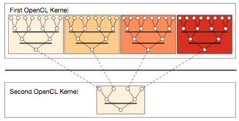
Case Study: Parallel Reduction in OpenCL
Summing up all values of an array
Comparison of 7 implementations by Nvidia
Investigating complexity and efficiency of optimisations

Slide 4
Unoptimised Implementation Parallel Reduction
kernel void reduce0(global float* g_idata, global float* g_odata,
unsigned int n, local float* l_data) {
unsigned int tid = get_local_id(0);
unsigned int i = get_global_id(0);
l_data[tid] = (i < n) ? g_idata[i] : 0;
barrier(CLK_LOCAL_MEM_FENCE);
// do reduction in local memory
for (unsigned int s=1; s < get_local_size(0); s*= 2) {
if ((tid % (2*s)) == 0) {
l_data[tid] += l_data[tid + s];
}
barrier(CLK_LOCAL_MEM_FENCE);
}
// write result for this work-group to global memory
if (tid == 0) g_odata[get_group_id(0)] = l_data[0];
}

Slide 5
Avoid Divergent Branching
kernel void reduce1(global float* g_idata, global float* g_odata,
unsigned int n, local float* l_data) {
unsigned int tid = get_local_id(0);
unsigned int i = get_global_id(0);
l_data[tid] = (i < n) ? g_idata[i] : 0;
barrier(CLK_LOCAL_MEM_FENCE);
for (unsigned int s=1; s < get_local_size(0); s*= 2) {
// continuous work-items remain active
int index = 2 * s * tid;
if (index < get_local_size(0)) {
l_data[index] += l_data[index + s];
}
barrier(CLK_LOCAL_MEM_FENCE);
}
if (tid == 0) g_odata[get_group_id(0)] = l_data[0];
}

Slide 6
Avoid Interleaved Addressing
kernel void reduce2(global float* g_idata, global float* g_odata,
unsigned int n, local float* l_data) {
unsigned int tid = get_local_id(0);
unsigned int i = get_global_id(0);
l_data[tid] = (i < n) ? g_idata[i] : 0;
barrier(CLK_LOCAL_MEM_FENCE);
// process elements in different order
// requires commutativity
for (unsigned int s=get_local_size(0)/2; s>0; s>>=1) {
if (tid < s) {
l_data[tid] += l_data[tid + s];
}
barrier(CLK_LOCAL_MEM_FENCE);
}
if (tid == 0) g_odata[get_group_id(0)] = l_data[0];
}

Slide 7
Increase Computational Intensity per Work-Item
kernel void reduce3(global float* g_idata, global float* g_odata,
unsigned int n, local float* l_data) {
unsigned int tid = get_local_id(0);
unsigned int i = get_group_id(0) * (get_local_size(0)*2)
+ get_local_id(0);
l_data[tid] = (i < n) ? g_idata[i] : 0;
// performs first addition during loading
if (i + get_local_size(0) < n)
l_data[tid] += g_idata[i+get_local_size(0)];
barrier(CLK_LOCAL_MEM_FENCE);
for (unsigned int s=get_local_size(0)/2; s>0; s>>=1) {
if (tid < s) {
l_data[tid] += l_data[tid + s];
}
barrier(CLK_LOCAL_MEM_FENCE);
}
if (tid == 0) g_odata[get_group_id(0)] = l_data[0];
}

Slide 8
Avoid Synchronisation inside a Warp
kernel void reduce4(global float* g_idata, global float* g_odata,
unsigned int n, local volatile float* l_data) {
unsigned int tid = get_local_id(0);
unsigned int i = get_group_id(0) * (get_local_size(0)*2)
+ get_local_id(0);
l_data[tid] = (i < n) ? g_idata[i] : 0;
if (i + get_local_size(0) < n)
l_data[tid] += g_idata[i+get_local_size(0)];
barrier(CLK_LOCAL_MEM_FENCE);
# pragma unroll 1
for (unsigned int s=get_local_size(0)/2; s>32; s>>=1) {
if (tid < s) { l_data[tid] += l_data[tid + s]; }
barrier(CLK_LOCAL_MEM_FENCE); }
// this is not portable OpenCL code!
if (tid < 32) {
if (WG_SIZE >= 64) { l_data[tid] += l_data[tid+32]; }
if (WG_SIZE >= 32) { l_data[tid] += l_data[tid+16]; }
if (WG_SIZE >= 16) { l_data[tid] += l_data[tid+ 8]; }
if (WG_SIZE >= 8) { l_data[tid] += l_data[tid+ 4]; }
if (WG_SIZE >= 4) { l_data[tid] += l_data[tid+ 2]; }
if (WG_SIZE >= 2) { l_data[tid] += l_data[tid+ 1]; } }
if (tid == 0) g_odata[get_group_id(0)] = l_data[0]; }

Slide 9
Complete Loop Unrolling
kernel void reduce5(global float* g_idata, global float* g_odata,
unsigned int n, local volatile float* l_data) {
unsigned int tid = get_local_id(0);
unsigned int i = get_group_id(0) * (get_local_size(0)*2)
+ get_local_id(0);
l_data[tid] = (i < n) ? g_idata[i] : 0;
if (i + get_local_size(0) < n)
l_data[tid] += g_idata[i+get_local_size(0)];
barrier(CLK_LOCAL_MEM_FENCE);
if (WG_SIZE >= 256) {
if (tid < 128) { l_data[tid] += l_data[tid+128]; }
barrier(CLK_LOCAL_MEM_FENCE); }
if (WG_SIZE >= 128) {
if (tid < 64) { l_data[tid] += l_data[tid+ 64]; }
barrier(CLK_LOCAL_MEM_FENCE); }
if (tid < 32) {
if (WG_SIZE >= 64) { l_data[tid] += l_data[tid+32]; }
if (WG_SIZE >= 32) { l_data[tid] += l_data[tid+16]; }
if (WG_SIZE >= 16) { l_data[tid] += l_data[tid+ 8]; }
if (WG_SIZE >= 8) { l_data[tid] += l_data[tid+ 4]; }
if (WG_SIZE >= 4) { l_data[tid] += l_data[tid+ 2]; }
if (WG_SIZE >= 2) { l_data[tid] += l_data[tid+ 1]; } }
if (tid == 0) g_odata[get_group_id(0)] = l_data[0]; }

Slide 10
Fully Optimised Implementation
kernel void reduce6(global float* g_idata, global float* g_odata,
unsigned int n, local volatile float* l_data) {
unsigned int tid = get_local_id(0);
unsigned int i = get_group_id(0) * (get_local_size(0)*2)
+ get_local_id(0);
unsigned int gridSize = WG_SIZE * get_num_groups(0);
l_data[tid] = 0;
while (i < n) { l_data[tid] += g_idata[i];
if (i + WG_SIZE < n)
l_data[tid] += g_idata[i+WG_SIZE];
i += gridSize; }
barrier(CLK_LOCAL_MEM_FENCE);
if (WG_SIZE >= 256) {
if (tid < 128) { l_data[tid] += l_data[tid+128]; }
barrier(CLK_LOCAL_MEM_FENCE); }
if (WG_SIZE >= 128) {
if (tid < 64) { l_data[tid] += l_data[tid+ 64]; }
barrier(CLK_LOCAL_MEM_FENCE); }
if (tid < 32) {
if (WG_SIZE >= 64) { l_data[tid] += l_data[tid+32]; }
if (WG_SIZE >= 32) { l_data[tid] += l_data[tid+16]; }
if (WG_SIZE >= 16) { l_data[tid] += l_data[tid+ 8]; }
if (WG_SIZE >= 8) { l_data[tid] += l_data[tid+ 4]; }
if (WG_SIZE >= 4) { l_data[tid] += l_data[tid+ 2]; }
if (WG_SIZE >= 2) { l_data[tid] += l_data[tid+ 1]; } }
if (tid == 0) g_odata[get_group_id(0)] = l_data[0]; }

Slide 11
Case Study Conclusions
kernel
void reduce6(global float* g_idata,
global float* g_odata,
unsigned int n,
local volatile float* l_data) {
unsigned int tid = get_local_id(0);
unsigned int i =
get_group_id(0) * (get_local_size(0)*2)
+ get_local_id(0);
unsigned int gridSize =
WG_SIZE * get_num_groups(0);
l_data[tid] = 0;
while (i < n) {
l_data[tid] += g_idata[i];
if (i + WG_SIZE < n)
l_data[tid] += g_idata[i+WG_SIZE];
i += gridSize; }
barrier(CLK_LOCAL_MEM_FENCE);
if (WG_SIZE >= 256) {
if (tid < 128) {
l_data[tid] += l_data[tid+128]; }
barrier(CLK_LOCAL_MEM_FENCE); }
if (WG_SIZE >= 128) {
if (tid < 64) {
l_data[tid] += l_data[tid+ 64]; }
barrier(CLK_LOCAL_MEM_FENCE); }
if (tid < 32) {
if (WG_SIZE >= 64) {
l_data[tid] += l_data[tid+32]; }
if (WG_SIZE >= 32) {
l_data[tid] += l_data[tid+16]; }
if (WG_SIZE >= 16) {
l_data[tid] += l_data[tid+ 8]; }
if (WG_SIZE >= 8) {
l_data[tid] += l_data[tid+ 4]; }
if (WG_SIZE >= 4) {
l_data[tid] += l_data[tid+ 2]; }
if (WG_SIZE >= 2) {
l_data[tid] += l_data[tid+ 1]; } }
if (tid == 0)
g_odata[get_group_id(0)] = l_data[0];
}
Optimising OpenCL is complex
Understanding of target hardware required
Program changes not obvious
Is it worth it? …
kernel
void reduce0(global float* g_idata,
global float* g_odata,
unsigned int n,
local float* l_data) {
unsigned int tid = get_local_id(0);
unsigned int i = get_global_id(0);
l_data[tid] = (i < n) ? g_idata[i] : 0;
barrier(CLK_LOCAL_MEM_FENCE);
for (unsigned int s=1;
s < get_local_size(0); s*= 2) {
if ((tid % (2*s)) == 0) {
l_data[tid] += l_data[tid + s];
}
barrier(CLK_LOCAL_MEM_FENCE);
}
if (tid == 0)
g_odata[get_group_id(0)] = l_data[0];
}
Unoptimized Implementation
Fully Optimized Implementation

Slide 12
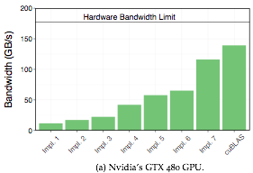
Performance Results Nvidia
… Yes! Optimising improves performance by a factor of 10!
Optimising is important, but …

Slide 13
Performance Results AMD and Intel
… unfortunately, optimisations in OpenCL are not portable!
Challenge: how to achieving portable performance?

Slide 14
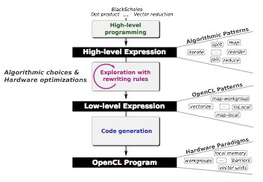
Generating Performance Portable Code using Rewrite Rules
Goal: automatic generation of Performance Portable code

Slide 15
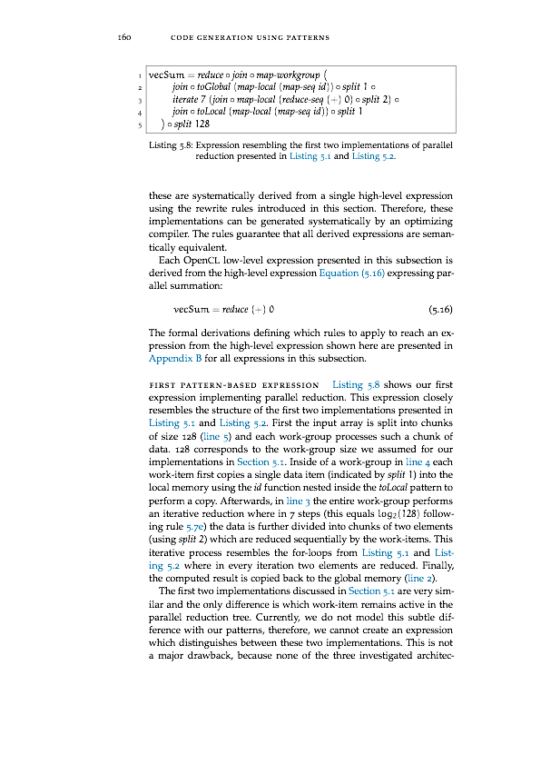
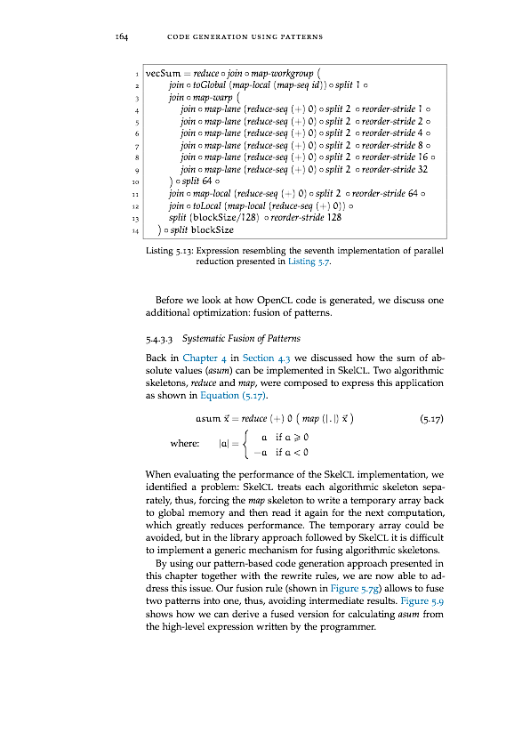
Walkthrough
③
kernel
void reduce6(global float* g_idata,
global float* g_odata,
unsigned int n,
local volatile float* l_data) {
unsigned int tid = get_local_id(0);
unsigned int i =
get_group_id(0) * (get_local_size(0)*2)
+ get_local_id(0);
unsigned int gridSize =
WG_SIZE * get_num_groups(0);
l_data[tid] = 0;
while (i < n) {
l_data[tid] += g_idata[i];
if (i + WG_SIZE < n)
l_data[tid] += g_idata[i+WG_SIZE];
i += gridSize; }
barrier(CLK_LOCAL_MEM_FENCE);
if (WG_SIZE >= 256) {
if (tid < 128) {
l_data[tid] += l_data[tid+128]; }
barrier(CLK_LOCAL_MEM_FENCE); }
if (WG_SIZE >= 128) {
if (tid < 64) {
l_data[tid] += l_data[tid+ 64]; }
barrier(CLK_LOCAL_MEM_FENCE); }
if (tid < 32) {
if (WG_SIZE >= 64) {
l_data[tid] += l_data[tid+32]; }
if (WG_SIZE >= 32) {
l_data[tid] += l_data[tid+16]; }
if (WG_SIZE >= 16) {
l_data[tid] += l_data[tid+ 8]; }
if (WG_SIZE >= 8) {
l_data[tid] += l_data[tid+ 4]; }
if (WG_SIZE >= 4) {
l_data[tid] += l_data[tid+ 2]; }
if (WG_SIZE >= 2) {
l_data[tid] += l_data[tid+ 1]; } }
if (tid == 0)
g_odata[get_group_id(0)] = l_data[0];
}
①
rewrite rules
code generation
②

Slide 16
Walkthrough
③
kernel
void reduce6(global float* g_idata,
global float* g_odata,
unsigned int n,
local volatile float* l_data) {
unsigned int tid = get_local_id(0);
unsigned int i =
get_group_id(0) * (get_local_size(0)*2)
+ get_local_id(0);
unsigned int gridSize =
WG_SIZE * get_num_groups(0);
l_data[tid] = 0;
while (i < n) {
l_data[tid] += g_idata[i];
if (i + WG_SIZE < n)
l_data[tid] += g_idata[i+WG_SIZE];
i += gridSize; }
barrier(CLK_LOCAL_MEM_FENCE);
if (WG_SIZE >= 256) {
if (tid < 128) {
l_data[tid] += l_data[tid+128]; }
barrier(CLK_LOCAL_MEM_FENCE); }
if (WG_SIZE >= 128) {
if (tid < 64) {
l_data[tid] += l_data[tid+ 64]; }
barrier(CLK_LOCAL_MEM_FENCE); }
if (tid < 32) {
if (WG_SIZE >= 64) {
l_data[tid] += l_data[tid+32]; }
if (WG_SIZE >= 32) {
l_data[tid] += l_data[tid+16]; }
if (WG_SIZE >= 16) {
l_data[tid] += l_data[tid+ 8]; }
if (WG_SIZE >= 8) {
l_data[tid] += l_data[tid+ 4]; }
if (WG_SIZE >= 4) {
l_data[tid] += l_data[tid+ 2]; }
if (WG_SIZE >= 2) {
l_data[tid] += l_data[tid+ 1]; } }
if (tid == 0)
g_odata[get_group_id(0)] = l_data[0];
}
①
rewrite rules
code generation
②

Slide 17
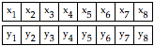
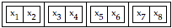
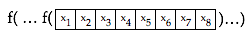
① Algorithmic Primitives
map(f) :
⟼
zip:
⟼
reduce(+, 0):
⟼
split(n):
⟼
join:
⟼
iterate(f, n):
⟼
reorder(σ):
⟼

Slide 18
① High-Level Programs
scal(a, vec) = map(*a, vec)
asum(vec) = reduce(+, 0, map(abs, vec))
dotProduct(x, y) = reduce(+, 0, map(*, zip(x, y)))
gemv(mat, x, y, a, b) =
map(+, zip(
map(scal(a) o dotProduct(x), mat),
scal(b, y) ) )

Slide 19
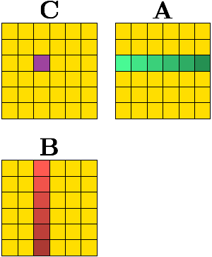
① High-Level Programs
A x B =
map(rowA ->
map(colB ->
dotProduct(rowA, colB)
, transpose(B))
, A)

Slide 20
Walkthrough
③
kernel
void reduce6(global float* g_idata,
global float* g_odata,
unsigned int n,
local volatile float* l_data) {
unsigned int tid = get_local_id(0);
unsigned int i =
get_group_id(0) * (get_local_size(0)*2)
+ get_local_id(0);
unsigned int gridSize =
WG_SIZE * get_num_groups(0);
l_data[tid] = 0;
while (i < n) {
l_data[tid] += g_idata[i];
if (i + WG_SIZE < n)
l_data[tid] += g_idata[i+WG_SIZE];
i += gridSize; }
barrier(CLK_LOCAL_MEM_FENCE);
if (WG_SIZE >= 256) {
if (tid < 128) {
l_data[tid] += l_data[tid+128]; }
barrier(CLK_LOCAL_MEM_FENCE); }
if (WG_SIZE >= 128) {
if (tid < 64) {
l_data[tid] += l_data[tid+ 64]; }
barrier(CLK_LOCAL_MEM_FENCE); }
if (tid < 32) {
if (WG_SIZE >= 64) {
l_data[tid] += l_data[tid+32]; }
if (WG_SIZE >= 32) {
l_data[tid] += l_data[tid+16]; }
if (WG_SIZE >= 16) {
l_data[tid] += l_data[tid+ 8]; }
if (WG_SIZE >= 8) {
l_data[tid] += l_data[tid+ 4]; }
if (WG_SIZE >= 4) {
l_data[tid] += l_data[tid+ 2]; }
if (WG_SIZE >= 2) {
l_data[tid] += l_data[tid+ 1]; } }
if (tid == 0)
g_odata[get_group_id(0)] = l_data[0];
}
①
rewrite rules
code generation
②

Slide 21
Walkthrough
③
kernel
void reduce6(global float* g_idata,
global float* g_odata,
unsigned int n,
local volatile float* l_data) {
unsigned int tid = get_local_id(0);
unsigned int i =
get_group_id(0) * (get_local_size(0)*2)
+ get_local_id(0);
unsigned int gridSize =
WG_SIZE * get_num_groups(0);
l_data[tid] = 0;
while (i < n) {
l_data[tid] += g_idata[i];
if (i + WG_SIZE < n)
l_data[tid] += g_idata[i+WG_SIZE];
i += gridSize; }
barrier(CLK_LOCAL_MEM_FENCE);
if (WG_SIZE >= 256) {
if (tid < 128) {
l_data[tid] += l_data[tid+128]; }
barrier(CLK_LOCAL_MEM_FENCE); }
if (WG_SIZE >= 128) {
if (tid < 64) {
l_data[tid] += l_data[tid+ 64]; }
barrier(CLK_LOCAL_MEM_FENCE); }
if (tid < 32) {
if (WG_SIZE >= 64) {
l_data[tid] += l_data[tid+32]; }
if (WG_SIZE >= 32) {
l_data[tid] += l_data[tid+16]; }
if (WG_SIZE >= 16) {
l_data[tid] += l_data[tid+ 8]; }
if (WG_SIZE >= 8) {
l_data[tid] += l_data[tid+ 4]; }
if (WG_SIZE >= 4) {
l_data[tid] += l_data[tid+ 2]; }
if (WG_SIZE >= 2) {
l_data[tid] += l_data[tid+ 1]; } }
if (tid == 0)
g_odata[get_group_id(0)] = l_data[0];
}
①
rewrite rules
code generation
②

Slide 22
② Algorithmic Rewrite Rules
Provably correct rewrite rules
Express algorithmic implementation choices
Split-join rule:
Map fusion rule:
Reduce rules:

Slide 23
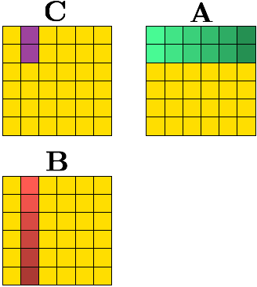
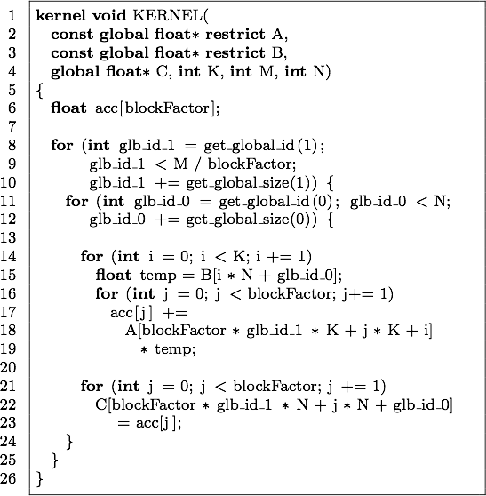
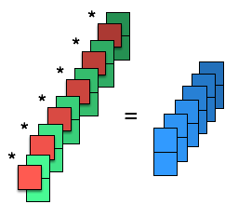
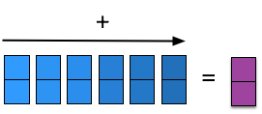
② Optimizations Expressed using Rewrite Rules Register Blocking
}
blockFactor
Notes:
we: series of rewrites => optimisation

Slide 24
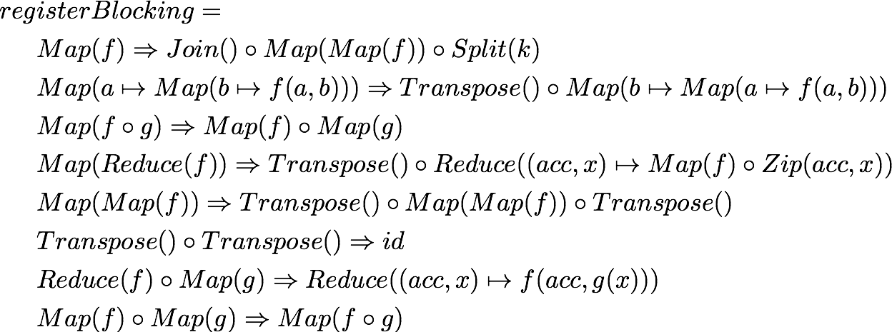
② Register Blocking as a Macro Rule
Optimizations are expressed as Macro Rules:
Series of Rewrites applied to achieve an optimization goal

Slide 25
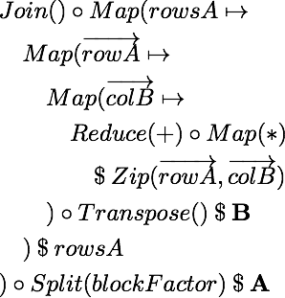
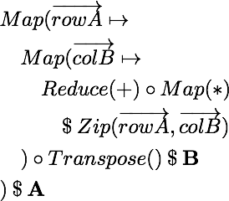
② Register Blocking as a Series of Rewrites
Notes:
split-join, divide and conquer REWRITE, NOT OPTIMISATION

Slide 26
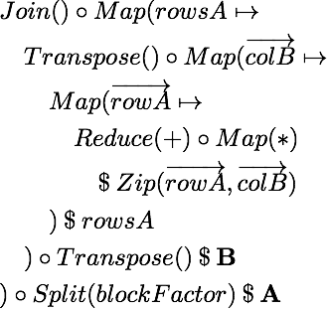
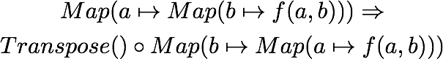
② Register Blocking as a Series of Rewrites
Notes:
map(map) interchange

Slide 27
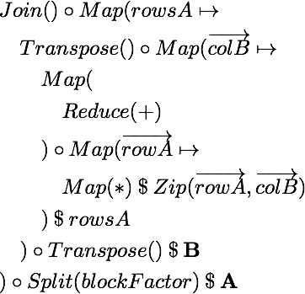
② Register Blocking as a Series of Rewrites
Notes:
map fission

Slide 28
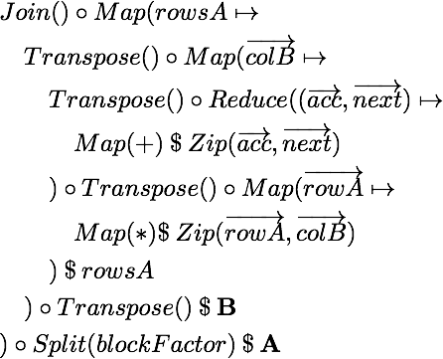
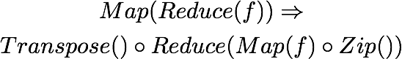
② Register Blocking as a Series of Rewrites
Notes:
map(reduce) interchange

Slide 29
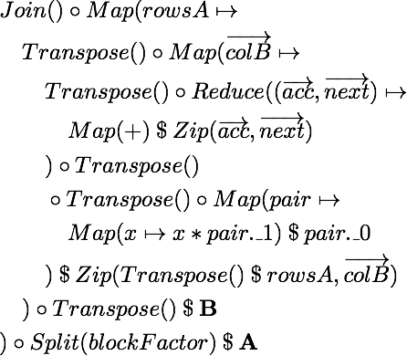
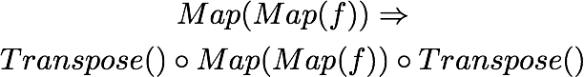
② Register Blocking as a Series of Rewrites
Notes:
map(map) interchange

Slide 30
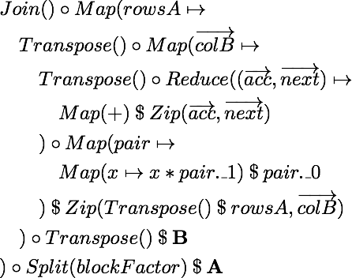
② Register Blocking as a Series of Rewrites

Slide 31
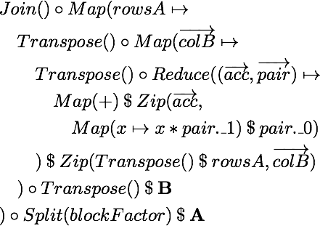
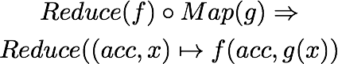
② Register Blocking as a Series of Rewrites
Notes:
map-reduce fusion

Slide 32
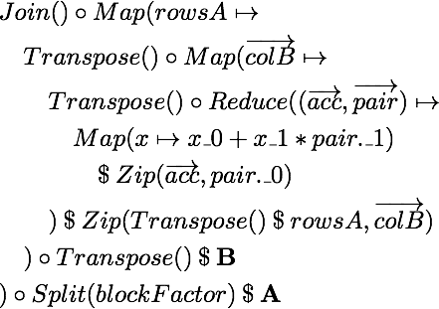
② Register Blocking as a Series of Rewrites
Notes:
map-map fusion

Slide 33
② Register Blocking Functionally Expressed
}
blockFactor

Slide 34
② OpenCL Primitives
Primitive
OpenCL concept
Work-items
Work-groups
Sequential implementations
,
Memory areas
,
Vectorization
,

Slide 35
② OpenCL Rewrite Rules
Express low-level implementation and optimisation choices
Map rules:
Local/ global memory rules:
Vectorisation rule:
Fusion rule:

Slide 36
Walkthrough
③
kernel
void reduce6(global float* g_idata,
global float* g_odata,
unsigned int n,
local volatile float* l_data) {
unsigned int tid = get_local_id(0);
unsigned int i =
get_group_id(0) * (get_local_size(0)*2)
+ get_local_id(0);
unsigned int gridSize =
WG_SIZE * get_num_groups(0);
l_data[tid] = 0;
while (i < n) {
l_data[tid] += g_idata[i];
if (i + WG_SIZE < n)
l_data[tid] += g_idata[i+WG_SIZE];
i += gridSize; }
barrier(CLK_LOCAL_MEM_FENCE);
if (WG_SIZE >= 256) {
if (tid < 128) {
l_data[tid] += l_data[tid+128]; }
barrier(CLK_LOCAL_MEM_FENCE); }
if (WG_SIZE >= 128) {
if (tid < 64) {
l_data[tid] += l_data[tid+ 64]; }
barrier(CLK_LOCAL_MEM_FENCE); }
if (tid < 32) {
if (WG_SIZE >= 64) {
l_data[tid] += l_data[tid+32]; }
if (WG_SIZE >= 32) {
l_data[tid] += l_data[tid+16]; }
if (WG_SIZE >= 16) {
l_data[tid] += l_data[tid+ 8]; }
if (WG_SIZE >= 8) {
l_data[tid] += l_data[tid+ 4]; }
if (WG_SIZE >= 4) {
l_data[tid] += l_data[tid+ 2]; }
if (WG_SIZE >= 2) {
l_data[tid] += l_data[tid+ 1]; } }
if (tid == 0)
g_odata[get_group_id(0)] = l_data[0];
}
①
rewrite rules
code generation
②

Slide 37
Walkthrough
③
kernel
void reduce6(global float* g_idata,
global float* g_odata,
unsigned int n,
local volatile float* l_data) {
unsigned int tid = get_local_id(0);
unsigned int i =
get_group_id(0) * (get_local_size(0)*2)
+ get_local_id(0);
unsigned int gridSize =
WG_SIZE * get_num_groups(0);
l_data[tid] = 0;
while (i < n) {
l_data[tid] += g_idata[i];
if (i + WG_SIZE < n)
l_data[tid] += g_idata[i+WG_SIZE];
i += gridSize; }
barrier(CLK_LOCAL_MEM_FENCE);
if (WG_SIZE >= 256) {
if (tid < 128) {
l_data[tid] += l_data[tid+128]; }
barrier(CLK_LOCAL_MEM_FENCE); }
if (WG_SIZE >= 128) {
if (tid < 64) {
l_data[tid] += l_data[tid+ 64]; }
barrier(CLK_LOCAL_MEM_FENCE); }
if (tid < 32) {
if (WG_SIZE >= 64) {
l_data[tid] += l_data[tid+32]; }
if (WG_SIZE >= 32) {
l_data[tid] += l_data[tid+16]; }
if (WG_SIZE >= 16) {
l_data[tid] += l_data[tid+ 8]; }
if (WG_SIZE >= 8) {
l_data[tid] += l_data[tid+ 4]; }
if (WG_SIZE >= 4) {
l_data[tid] += l_data[tid+ 2]; }
if (WG_SIZE >= 2) {
l_data[tid] += l_data[tid+ 1]; } }
if (tid == 0)
g_odata[get_group_id(0)] = l_data[0];
}
①
rewrite rules
code generation
②

Slide 38
③ Pattern based OpenCL Code Generation
Generate OpenCL code for each OpenCL primitive
for (int g_id = get_global_id(0); g_id < n;
g_id += get_global_size(0)) {
output[g_id] = f(xs[g_id]);
}
T acc = z;
for (int i = 0; i < n; ++i) {
acc = f(acc, xs[i]);
}

Slide 39
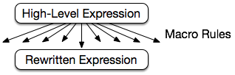
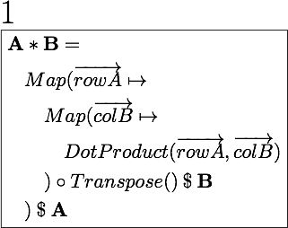
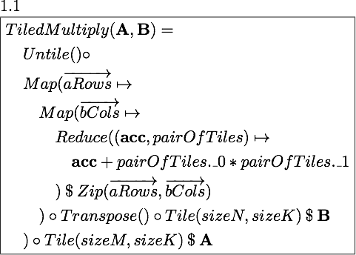
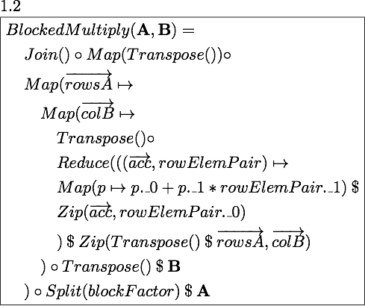
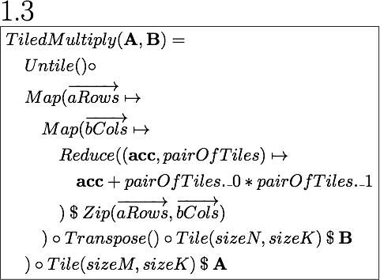
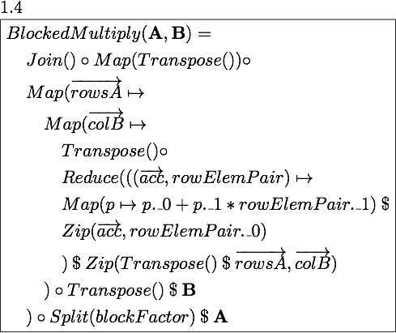
Exploration Strategy

Slide 40
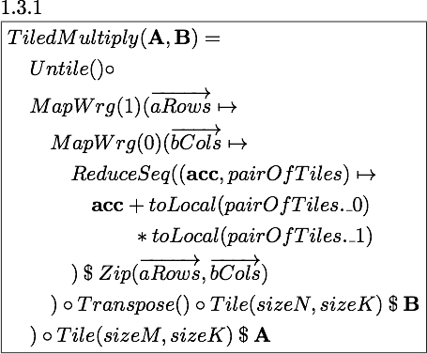
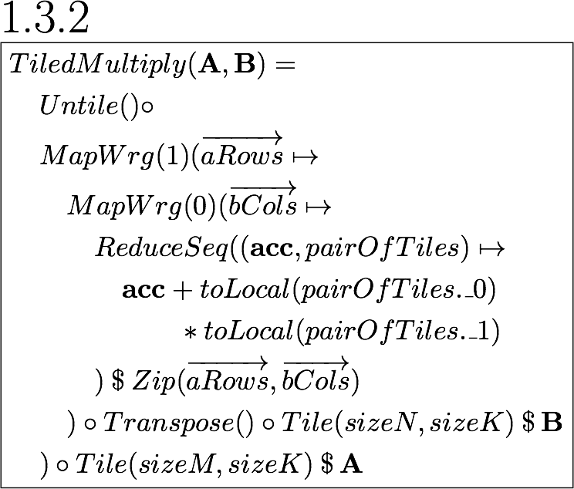
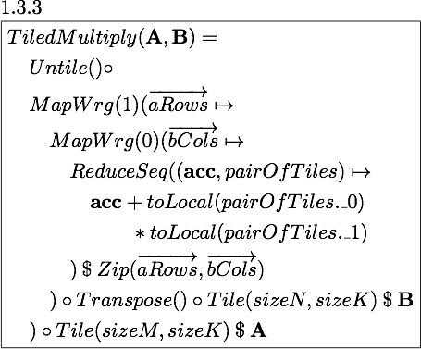
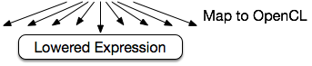
Exploration Strategy
Notes:
Rewritten has MapWrg

Slide 41
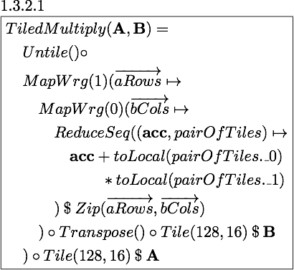
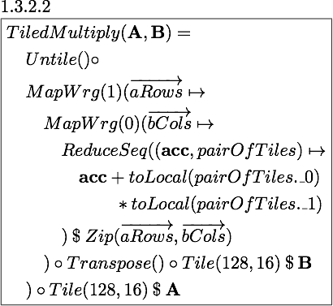
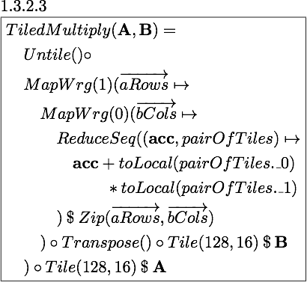
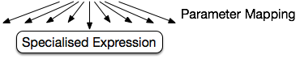
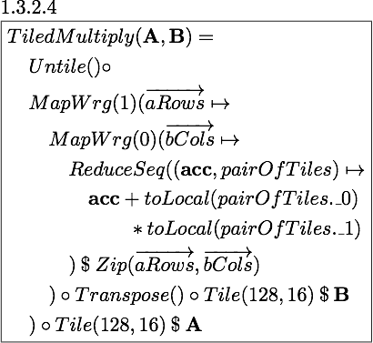
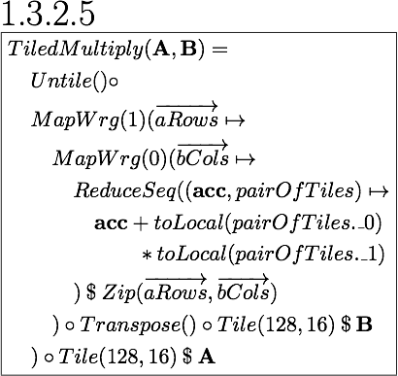
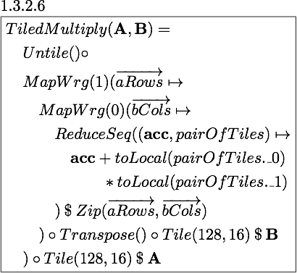
Exploration Strategy
Notes:
sizes

Slide 42
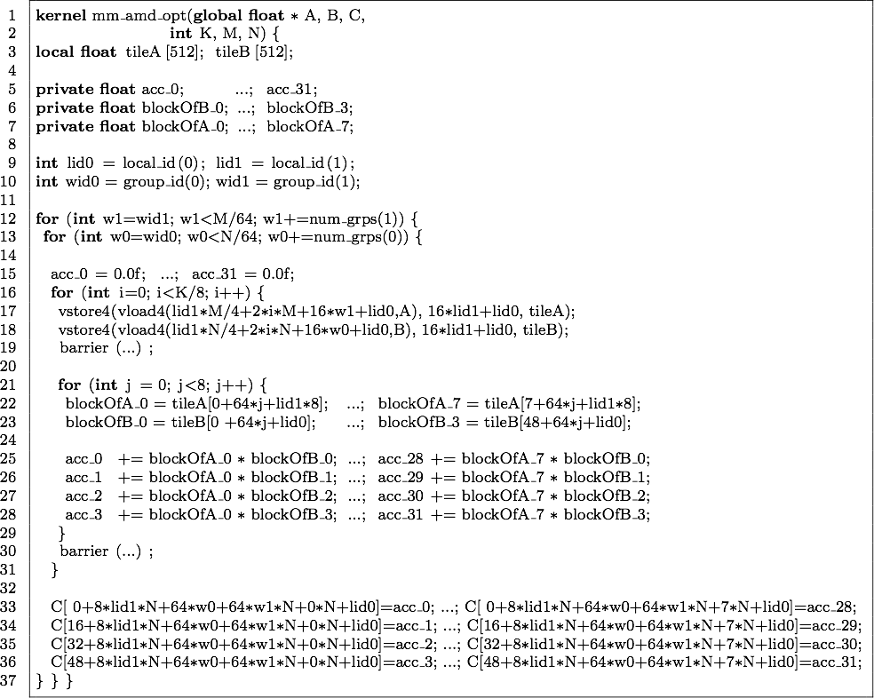
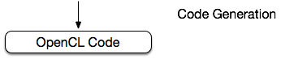
Exploration Strategy
Notes:
Explain heuristics

Slide 43
Heuristics
For Macro Rules:
Nesting depth
Distance of addition and multiplication
Number of times rules are applied
For Map to OpenCL:
Fixed parallelism mapping
Limited choices for mapping to local and global memory
Follows best practice
For Parameter Mapping:
Amount of memory used
Global
Local
Registers
Amount of parallelism
Work-items
Workgroup
Notes:
parameter mapping -> expert knowledge about gpus

Slide 44
Exploration in Numbers for Matrix Multiplication
1
8
760
46,000
Notes:
AFTER FILTERING; filtering throughout
tiny portion
lowering, quick
codegen 30min-60min
execution of all 46,000 OpenCL kernel took less than an hour on Tahiti and Kepler and about three hours on Fermi, including the overheads of data transfers, validation, etc. but excluding the kernel generation and compilation time.

Slide 45
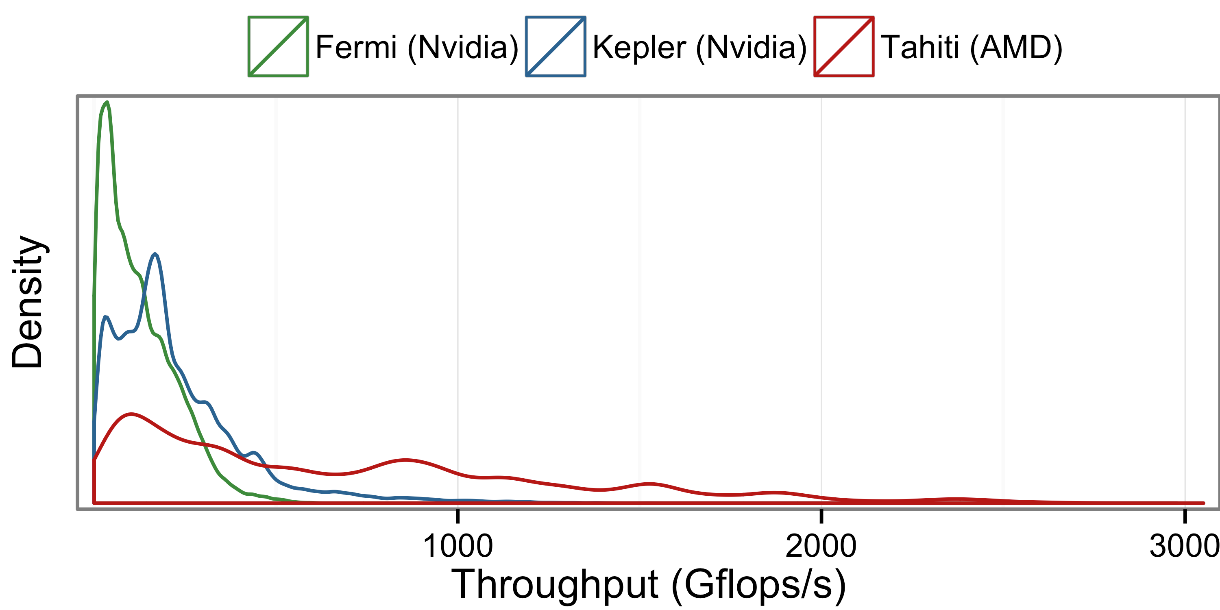
Exploration Space for Matrix Multiplication
Notes:
AFTER FILTERING; filtering throughout
tiny portion
lowering, quick
codegen 30min-60min
execution of all 46,000 OpenCL kernel took less than an hour on Tahiti and Kepler and about three hours on Fermi, including the overheads of data transfers, validation, etc. but excluding the kernel generation and compilation time.

Slide 46
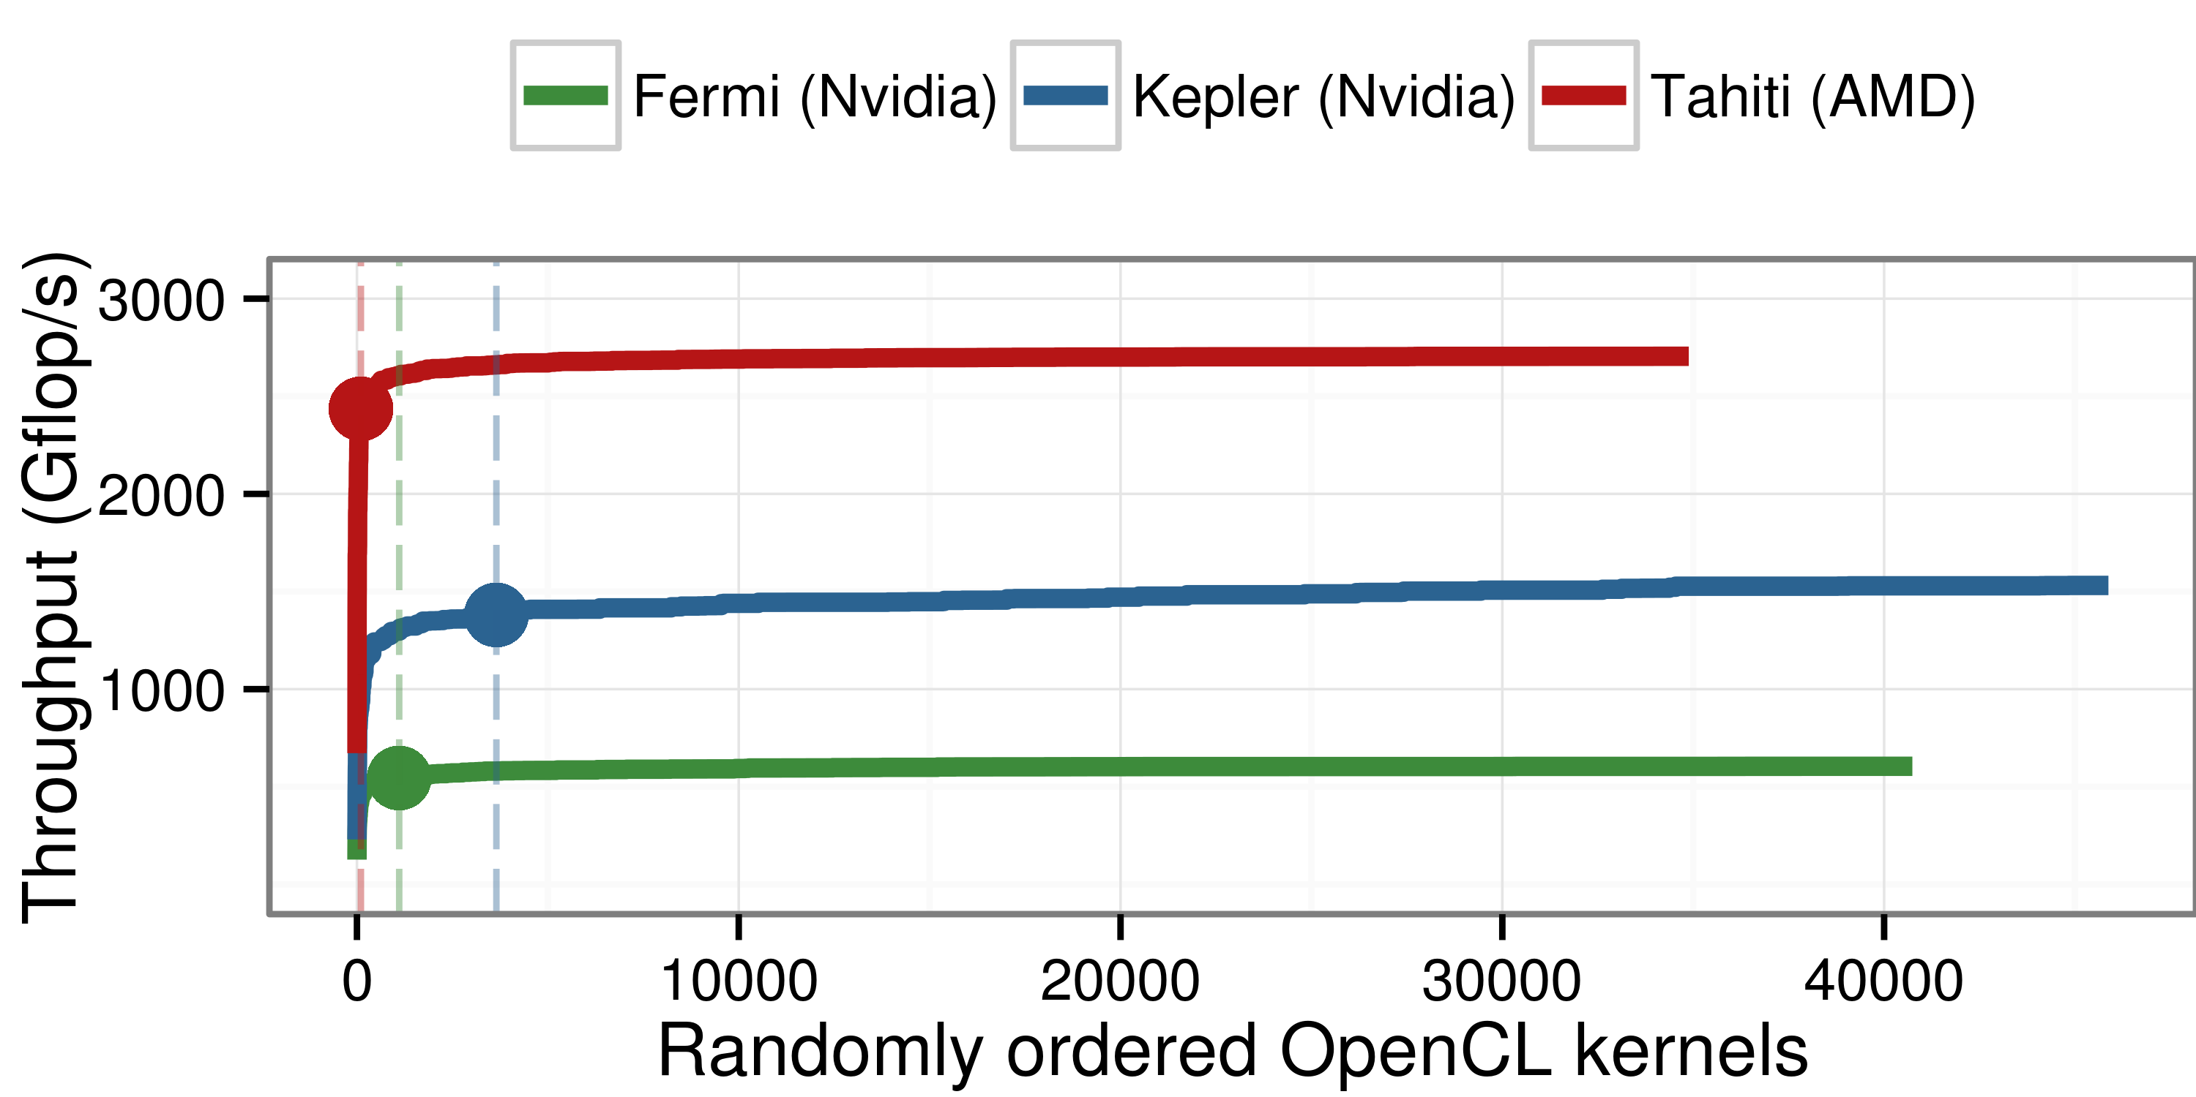
Performance Evaluation for Matrix Multiplication
Notes:
AFTER FILTERING; filtering throughout
tiny portion
lowering, quick
codegen 30min-60min
execution of all 46,000 OpenCL kernel took less than an hour on Tahiti and Kepler and about three hours on Fermi, including the overheads of data transfers, validation, etc. but excluding the kernel generation and compilation time.

Slide 47
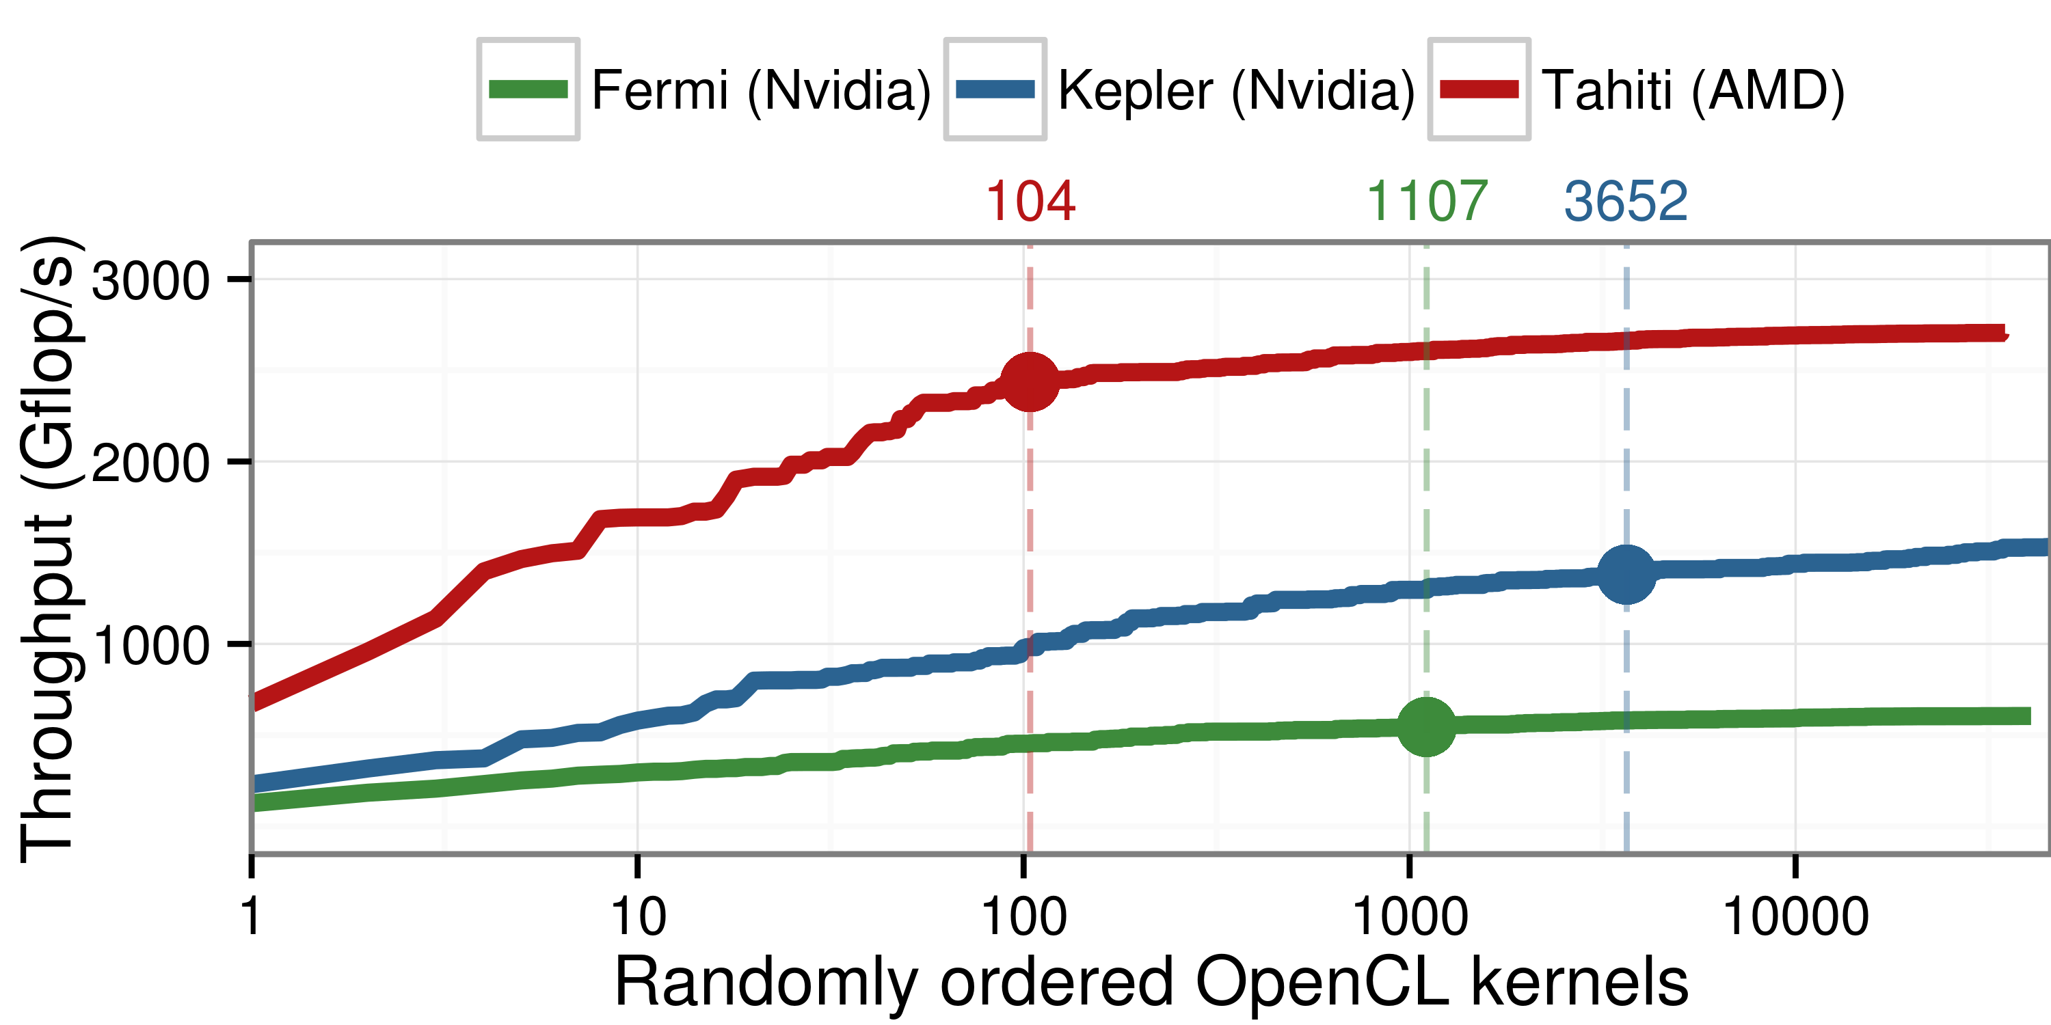
Performance Evaluation for Matrix Multiplication
Notes:
AFTER FILTERING; filtering throughout
tiny portion
lowering, quick
codegen 30min-60min
execution of all 46,000 OpenCL kernel took less than an hour on Tahiti and Kepler and about three hours on Fermi, including the overheads of data transfers, validation, etc. but excluding the kernel generation and compilation time.

Slide 48
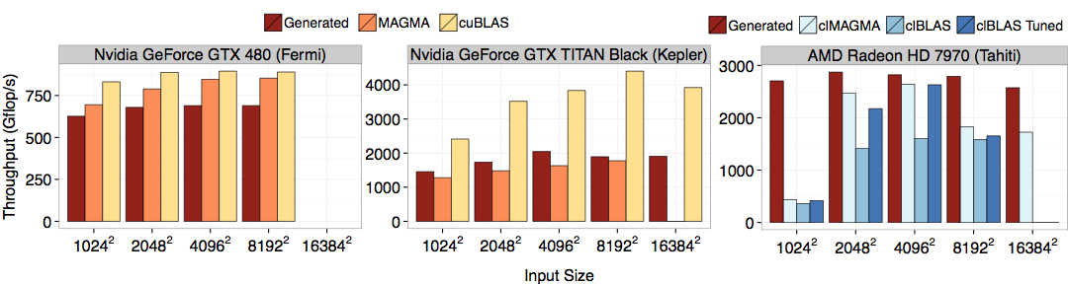
Performance Results Matrix Multiplication

Slide 49

Performance Results more benchmarks vs. Portable Implementation
Up to 20x speedup on fairly simple benchmarks vs. portable clBLAS implementation

Slide 50

Performance Results vs. Hardware-Specific Implementations
Automatically generated code vs. expert written code
Competitive performance vs. highly optimised implementations
Up to 4.5x speedup for gemv on AMD

Slide 51

Performance Portability Matrix Multiplication
Notes:
explain axes
Mention generations
NVIDIA fermi/kepler
AMD tahiti

Slide 52
Performance Portability Matrix Multiplication
Notes:
explain axes
Mention generations
NVIDIA fermi/kepler
AMD tahiti

Slide 53
Performance Portability Matrix Multiplication
Notes:
explain axes
Mention generations
NVIDIA fermi/kepler
AMD tahiti

Slide 54


Summary
OpenCL code is not performance portable
Our approach uses
portable and functional high-level primitives,
OpenCL-specific low-level primitives, and
rewrite-rules to generate high performance code.
Rewrite-rules define a space of possible implementations
Performance on par with specialised, highly-tuned code
Michel Steuwer — michel.steuwer@ed.ac.uk
supported by:

